Slide 1
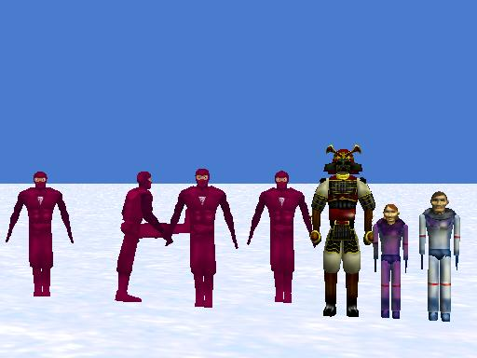
Lists Tutorial
By Deborah Nelson
Duke University
Professor Susan Rodger
July 13, 2008

Slide 2
Loading the World
Open a new world, with any template
Save it in a directory that you can find again,
After you have opened the file go into the "Layout" mode by clicking on the green button Add Objects (toward the middle of screen)
Click more controls. Click drop a dummy at the camera. Rename the dummy 'originalPosition.' To leave the layout mode, click done

Slide 3
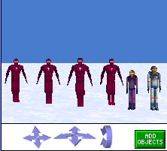
Adding the Objects
Go to the gallery and add four evilNinjas to your world (from the People folder)
Add two other people to your world
I’ve added the scientist-man and scientist-woman

Slide 4
Part 1: Making a List
We will use a list to make all four of the ninjas jump up and down together and then kick and spin one at a time
Click on the world in the object tree and on the properties tab
Click create new variable
Name it ‘characters’
See the screenshot on the next slide for an illustration

Slide 5
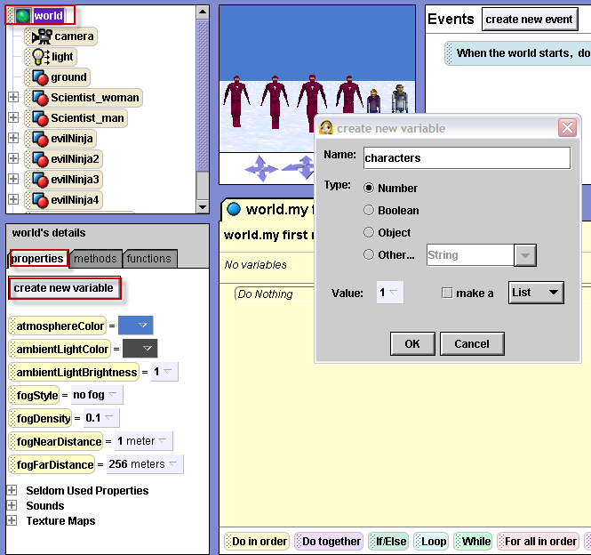

Slide 6
Making a list (cont 1)
Select “object” as the type
Check the box “make a List”
Click the “new item” button four times
For item0 select evilNinja
For item1 select evilNinja2
For item2 select evilNinja3
For item3 select evilNinja4
See the screenshot on the next slide for an illustration

Slide 7
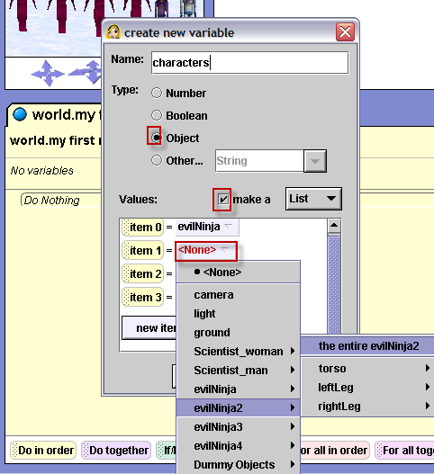

Slide 8
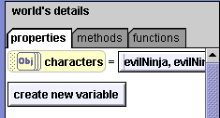
Making a List cont(2)
Now, there is a “characters” list variable at the top of the world “properties” tab

Slide 9
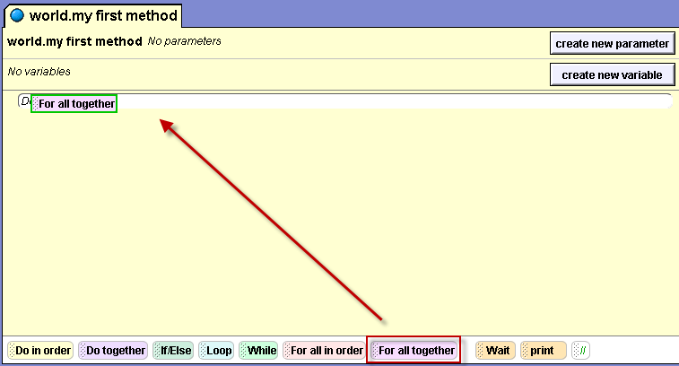
Part 2: Writing the method
Drag “for all together” into “world.my first method”

Slide 10
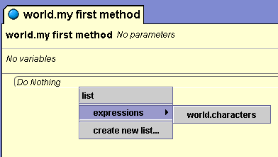
Writing the method (cont 1)
In the drop down menu, select “expressions”, then select the list world.characters
“For all together” means that all of the items in the list will perform the instructions at the same time.

Slide 11
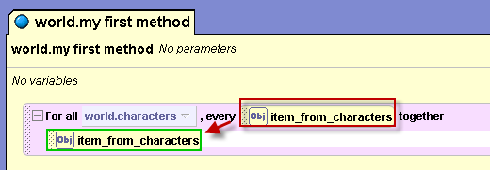
Step 1: For all together
Click on “item_from_characters”
And drag it on top of the “Do nothing”

Slide 12
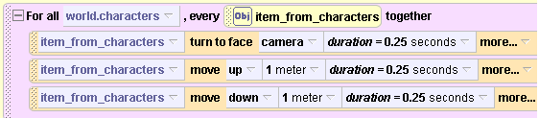
For all together (cont 1)
In the drop down menu, select “turn to face” and then select “camera”
Click on “more" to change the duration to 0.25
Drag “item_from_characters” again and select the “move” up and “move” down instructions.
Play your world. Your method should look like this:

Slide 13
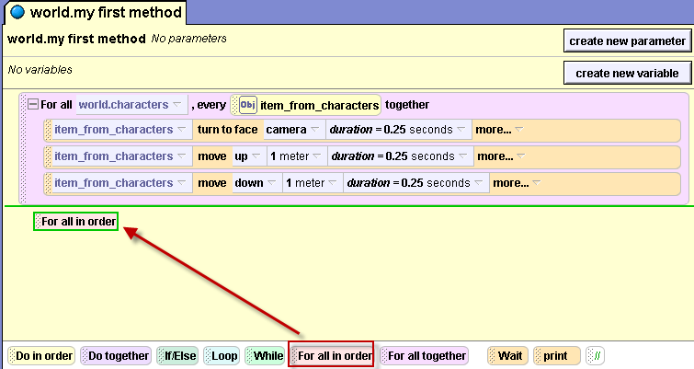
Step 2: For all in order
Now drag “for all in order” underneath the “for all together” and select “expressions”, then world.characters

Slide 14
For all in order (cont 1)
For all in order means the ninjas will perform all of the instructions, one right after the other (in the order that they were added to the list)
We want the ninjas to each turn their left leg and spin one at a time.
However, “item_from_characters” does not have any parts
We will have to use a class level built in function to turn only a part of the object.

Slide 15
For all in order (cont 2)
First, drag “item_from_characters” into the “for all in order” and select “turn backward” 1/4
Click on “evilNinja” in the object tree.
Select the “functions” tab and scroll down to “evilNinja’s part named key”

Slide 16
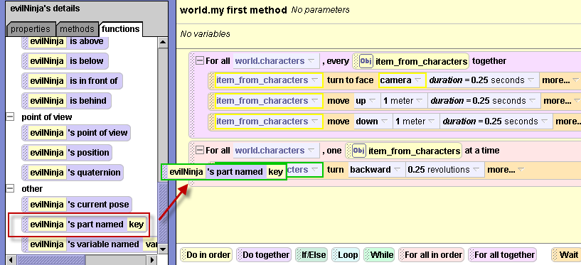
Step 3: Object part named key
Drag that function on top of the item_from_character in your instruction

Slide 17
Object part named key (cont 1)
In the object tree, expand the + beside evilNinja to see that it’s body part is named “leftLeg”
In the turn backward instruction, click on the box and type leftLeg with the same capitalization and spacing as it appears in the object tree – no spacing, the second L must be capitalized
See the screenshot on the next slide for an illustration

Slide 18
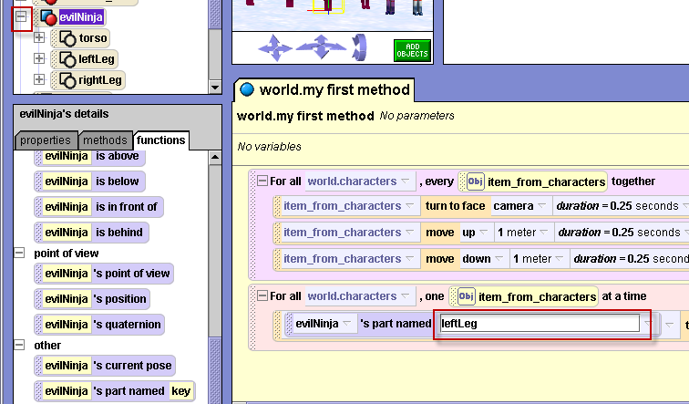
Object part named key (cont 3)

Slide 19

For all in order (cont 1)
Drag “item_from_characters” on top of evilNinja
Drag “item_from_characters” into the “for all in order” again and select “turn right” 1 revolution

Slide 20
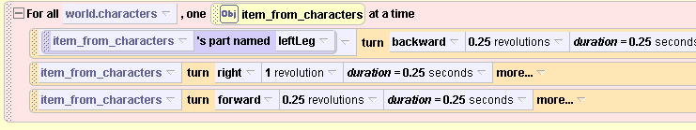
For all in order (cont 2)
Then drag “item_from_characters” again and select “turn forward” ¼. Your loop should look like this so far:

Slide 21
For all in order (cont 3)
That last instruction should be for the leftLeg only.
So drag the function “evilNinja’s part named key” on top of the “item_from_characters” and type in leftLeg again.
Drag “item_from_characters” on top of evilNinja in the “part named key”

Slide 22
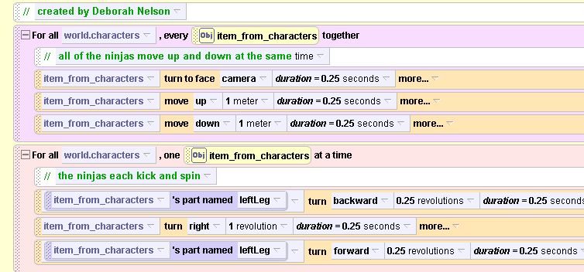
The complete method
Here is the complete method. Don’t forget to comment your code

Slide 23
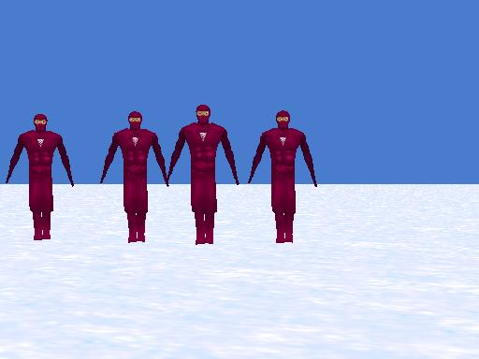
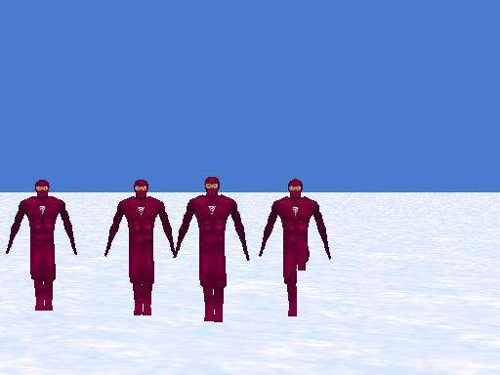
Play your world now

Slide 24
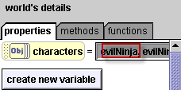
Step 4: Objects with different parts
So far, our list only has evilNinjas in it. Add the other objects to the list:
Click on world in the object tree
Go to the “properties” tab
and click on the box beside
characters
Click on “new item” and select the object you want to add
See the screenshot on the next slide for an illustration

Slide 25
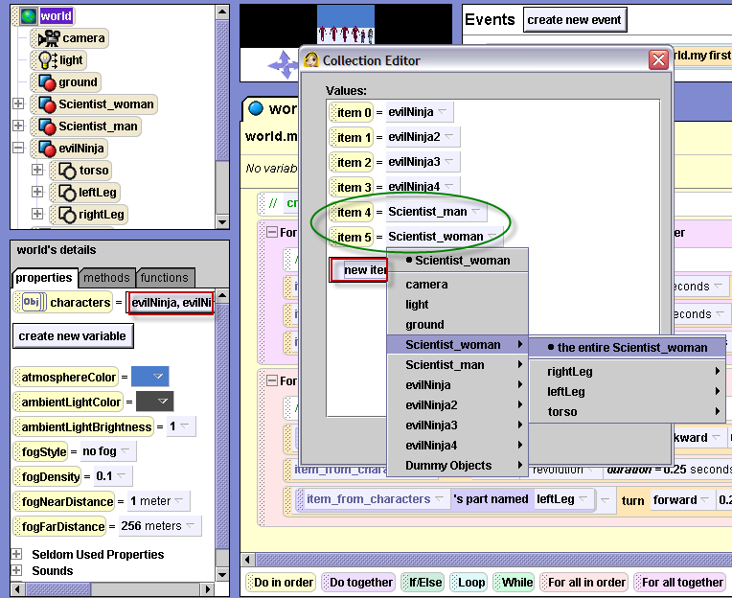

Slide 26
Warning
Play your world.
If you did not use the same objects as this demonstration, you may get an error highlighting the “parts named” function.
Adding the scientist-man and scientist-woman to the list only works because they both have leftLeg as the label for one of their body parts
If your character does not have a part named leftLeg you get the error

Slide 27
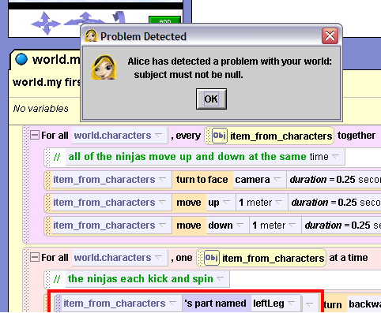
Fixing the error
For example, I’ve added the Samurai (from the web gallery People folder).
When I add him to my list and play the world, I get the following error:
Because the Samurai does not have a part named leftLeg

Slide 28

Fixing the error (cont 1)
In the object tree, click on the + beside Samurai
Double click on the body part named Lleg
Rename it leftLeg
Now play your world
Success!

Slide 29
How to remove an obj
To delete an object from your list:
Click on world in the object tree
Go to the “properties” tab
and click on the box beside
Characters
See the screenshot on the next slide for details.

Slide 30
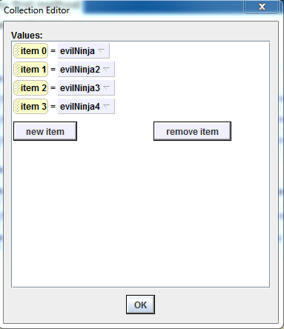
Deleting an object from your list
3) Click on the item that you want to delete and click “remove item”.

Slide 31
Recap
Lists are useful for having multiple characters perform the same set of actions.
For all together means everything in the list will perform at the same time
For all in order means everything in the list will happen one right after the other
To make the sub parts of an object move, use the function part named key. But make sure all of the characters have the same parts labeled the same way
WARNING: Do not add too many objects to your list because doing so will slow your world down significantly

